Slide 1
Software Architectures 2018/19 - MEB-POC Project
Group: LinuxFellows

Slide 2
Requirements
Functional
Dashboard-Queries
Dashboard-Filters
Dashboard-Default
Information-Structure
Information-Concurrency
Information-Processing
IO-Input
IO-Output
Non Functional
Scalability
Performance
Availability
Reliability

Slide 3
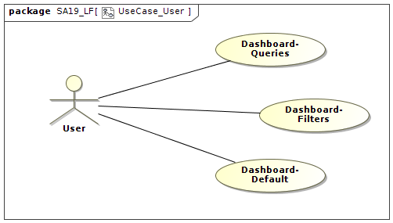
Use case - User

Slide 4
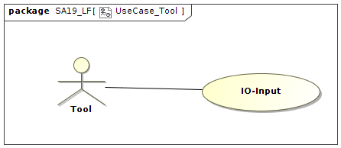
Use case - Tool

Slide 5
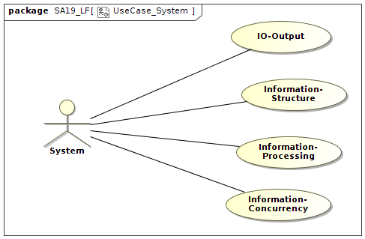
Use case - System

Slide 6
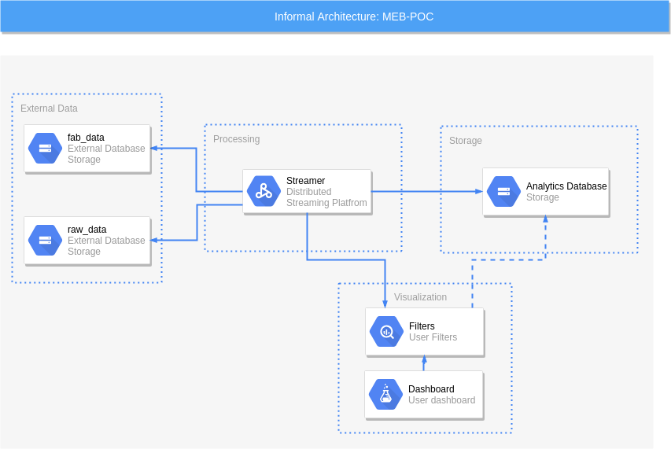
Informal description

Slide 7
Design decision #1
Problem: How does the system take the events from the tools?
Decided option: Pull events from the provided database.
Motivation: Number of messages & network traffic, fault-tolerance, loss of data, ease of simulation.

Slide 8
Design decision #2
Problem: Which architectural pattern should the system use?
Decided option: Publish/Subscribe
Motivation: Scalability (horizontal-scalability), de-coupling.

Slide 9
Design decision #3
Problem: Which message broker/streaming platform should the system use?
Decided option: Apache Kafka
Motivation: Real-time, persistence, history, team knowledge about the technology and available documentation, Kafka Connect and Stream API.

Slide 10
Design decision #4
Problem: How does the system handle raw_data?
Decided option: Internal Caching
Motivation: Memory usage, Performance, Scalability.

Slide 11
Design decision #5
Problem: Where are the information stored?
Decided option: Kafka State & External Database
Motivation: Fault-tolerance, Relations between the data, Simplicity of the architecture, Usage of third-parts dashboard systems.

Slide 12
Caps Design decision #1
Problem: How to illustrate the flow sequence of commands and data in the SAML diagram?
Decided option: AlphaNumeric Tagging with Alphabetic Sources.
Motivation: Human Readable, Easily Expandable, Easy to Follow.

Slide 13
Caps Design decision #2
Problem: How do we represent the tool output in CAPS?
Decided option: XML
Motivation: To comply with the specification assuming the fab_data database can convert XML.

Slide 14
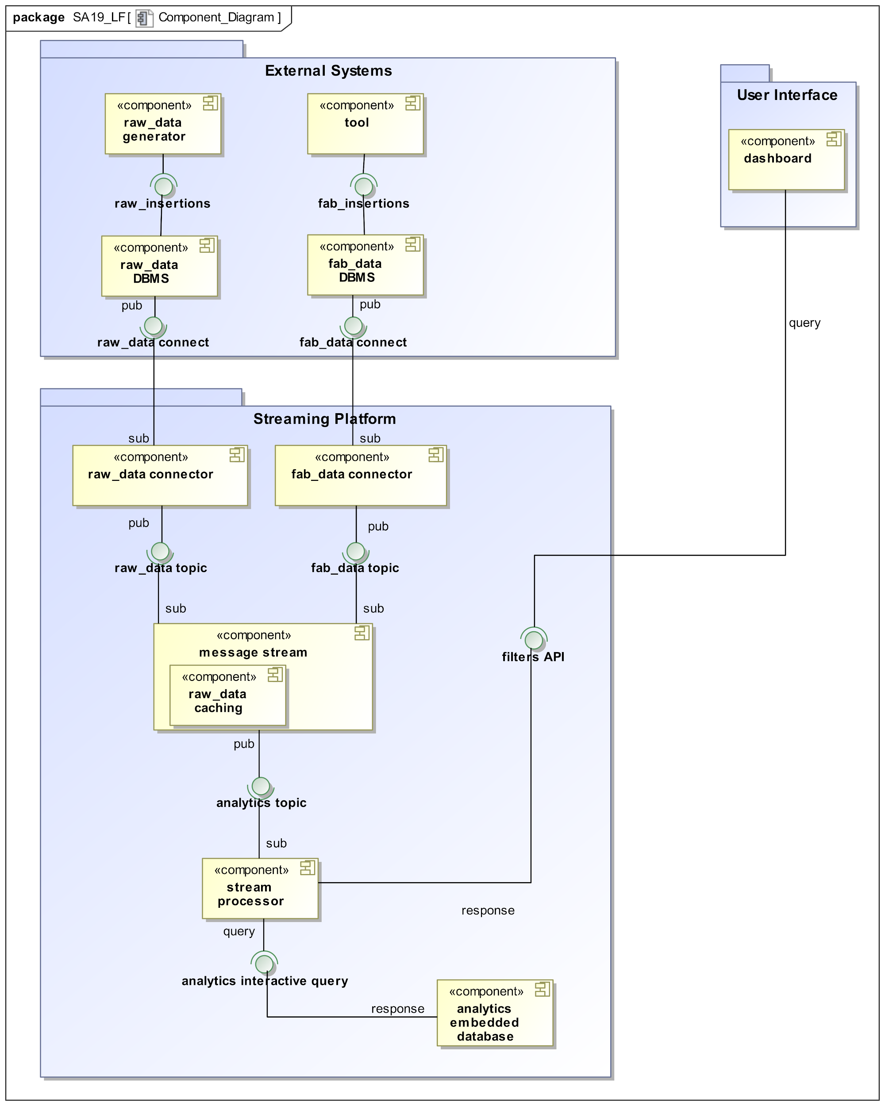
Component Diagram

Slide 15
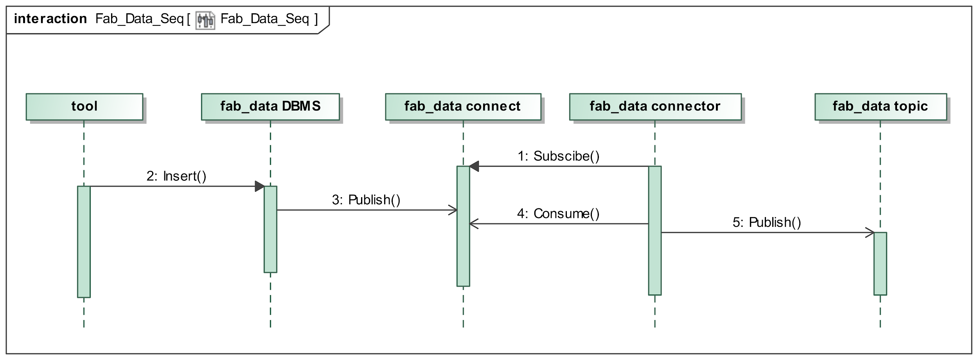
Sequence diagram - Kafka connect

Slide 16
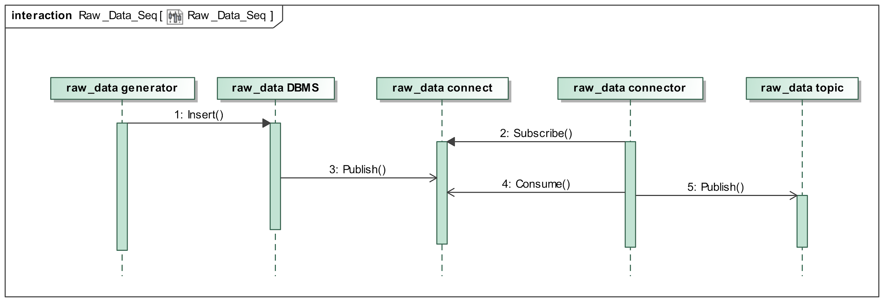
Sequence diagram - Kafka connect

Slide 17
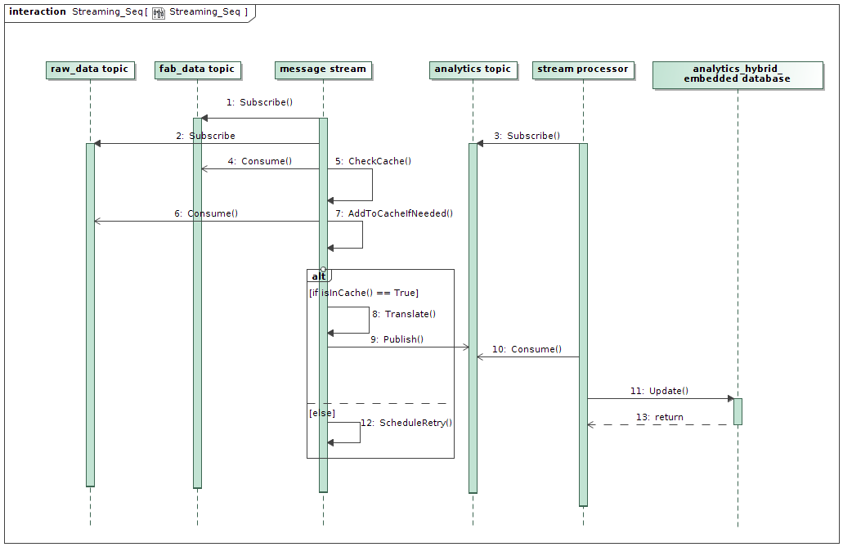
Sequence diagram - General

Slide 18
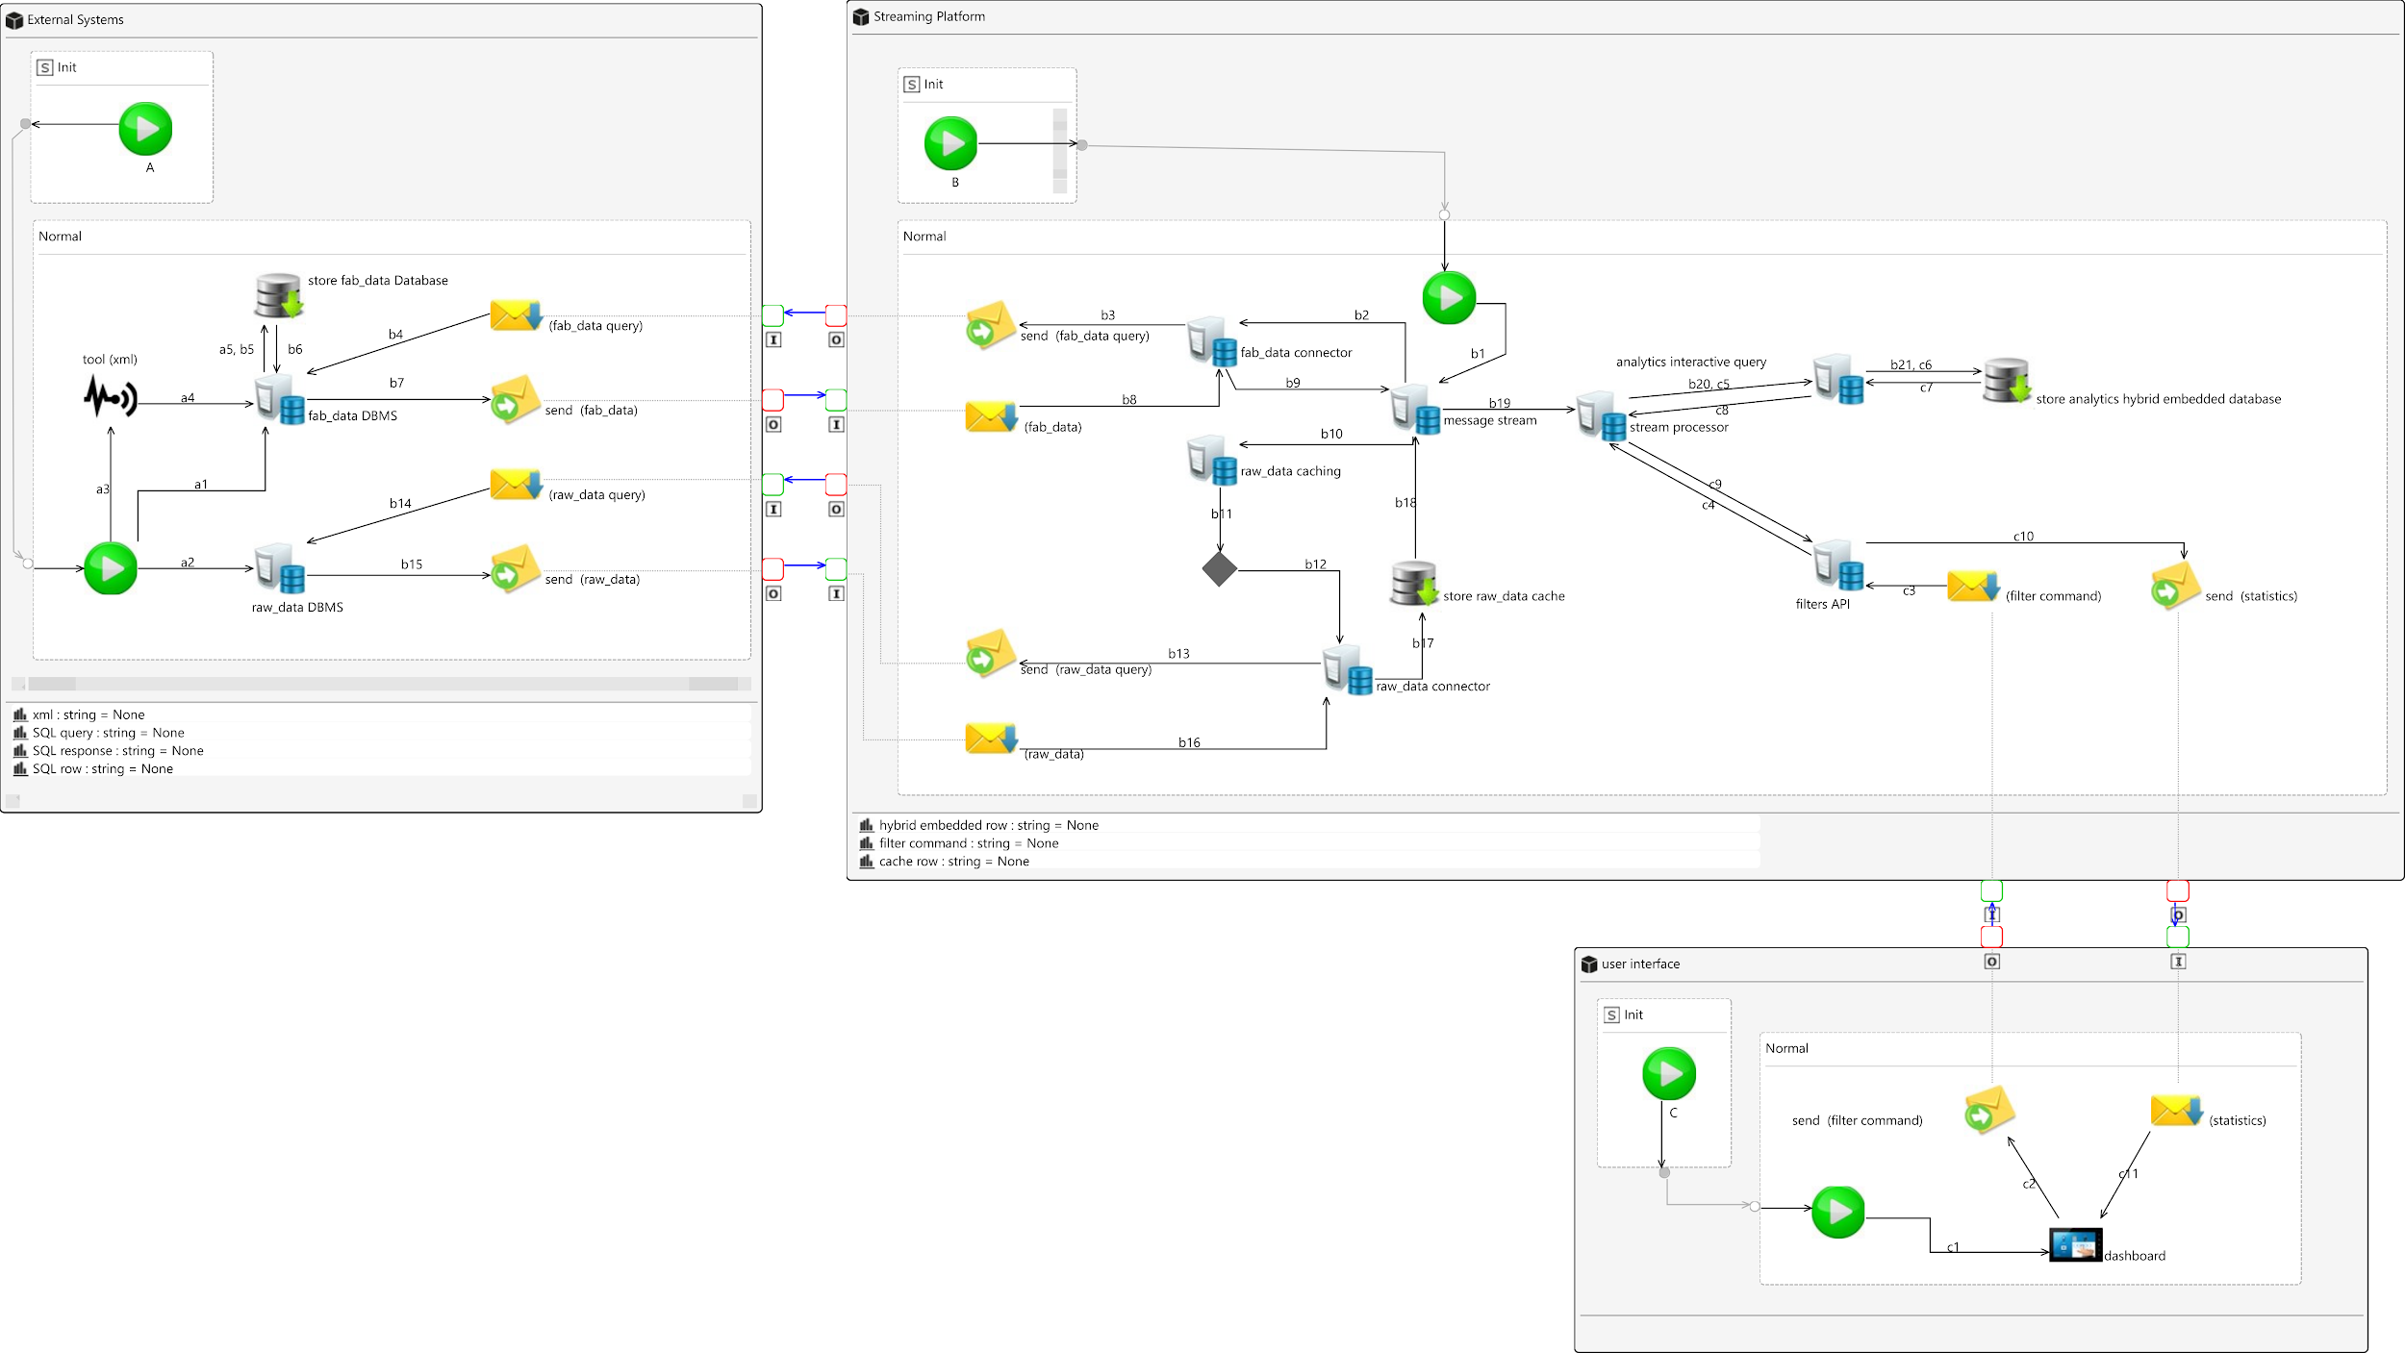
CAPS - SAML

Slide 19
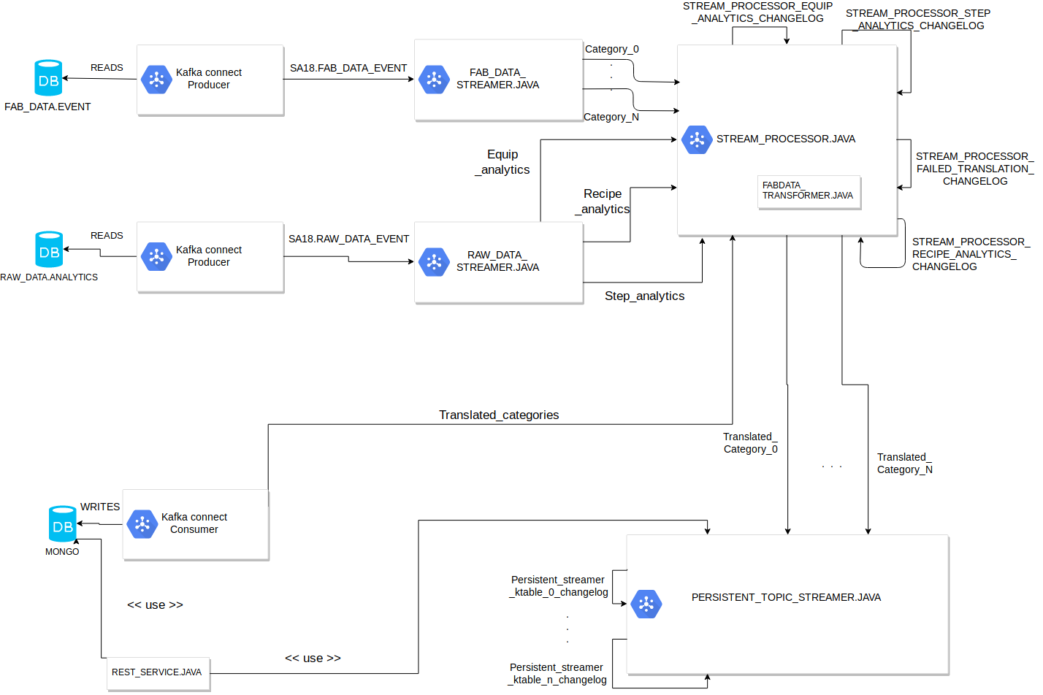
Topics diagram

Slide 20
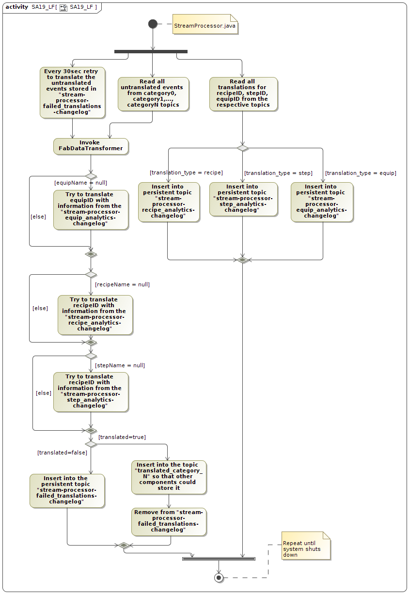
Translation
Logic

Slide 21
Sample of execution
Play the video…

